Slide 1
RNNs / LSTMs

Slide 2
Why Recurrent Neural Networks (RNNs)?
Humans don’t start their thinking from scratch every second.
As you read this essay, you understand each word based on your understanding of previous words.
You don’t throw everything away and start thinking from scratch again.
Not all problems can be converted into one with fixed length inputs and outputs
Problems such as Speech Recognition or Time-series Prediction require a system to store and use context information
It’s unclear how a traditional neural network could use its reasoning about previous to inform later ones.

Slide 3
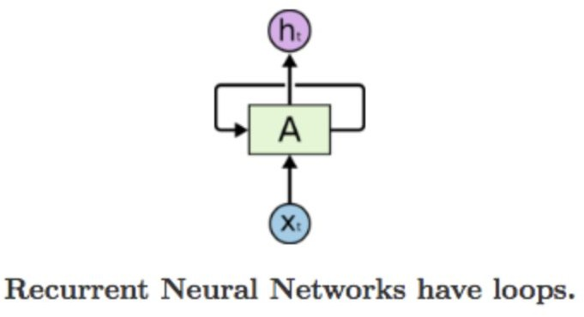
RNNs
RNNs address this issue!
Recurrent Neural Networks (RNNs) are designed to handle sequences, like sentences or time-based data, by remembering past information through a loop that passes historical context from one step to the next.
Unlike regular neural networks, which process inputs independently, an RNN has a "memory" component: at each step (time t), it takes the current input (e.g., a word in a sentence) and combines it with a hidden state (a summary of previous inputs) to produce an output.
This hidden state, updated at every step, acts like a running summary of what the network has seen so far, allowing it to understand context or patterns over time.
The loop structure ensures that information from earlier steps influences later ones, making RNNs useful for tasks like speech recognition or predicting the next word in a sentence, where prior context matters.

Slide 4
RNNs
The image of an unrolled recurrent neural network (RNN) visually represents how an RNN processes sequences (like text or time-series data) step by step over time. Instead of showing the "looped" structure of a standard RNN (where a single module feeds its output back into itself), unrolling "flattens" the loop into a chain of repeated, connected modules. Each module represents the RNN at a specific time step (e.g., t-1, t, t+1) and shares the same set of parameters (weights). At every step, the network takes two inputs: the current data (like a word in a sentence, shown as xₜ) and the hidden state from the previous step (a summary of past information, shown as hₜ₋₁). It then updates the hidden state (hₜ) and produces an output (oₜ). This unrolled view makes it easier to see how information flows through time, with each step influenced by prior context, allowing the RNN to learn patterns that depend on sequences (e.g., predicting the next word in a sentence or understanding video frames).

Slide 5
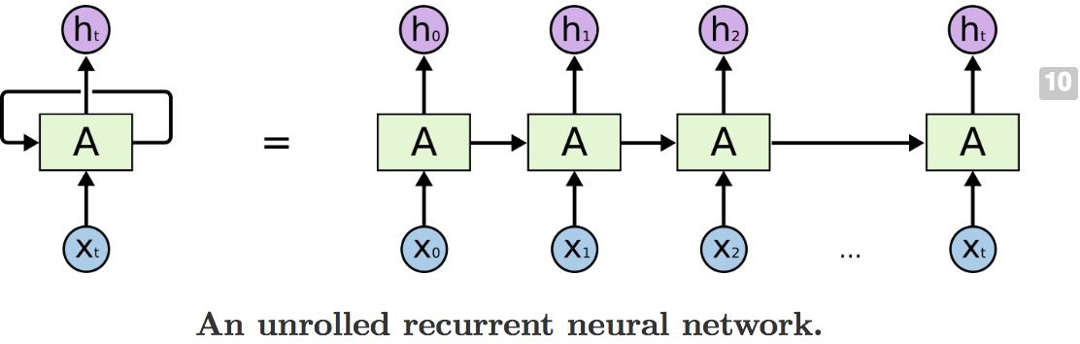
RNNs

Slide 6
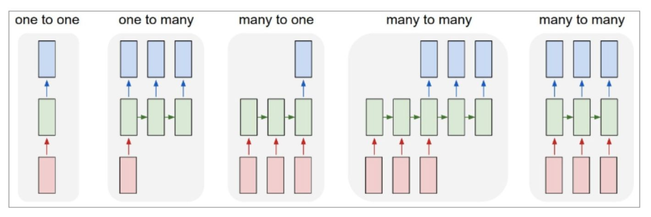
RNNs offer a lot of flexibility
Vanilla Neural Networks
Each rectangle is a vector and arrows represent functions (eg. Matrix multiplication)

Slide 7
RNNs offer a lot of flexibility
e.g. Image Captioning
image -> sequence of words
Each rectangle is a vector and arrows represent functions (eg. Matrix multiplication)

Slide 8
RNNs offer a lot of flexibility
e.g. Sentiment Classification
sequence of words -> sentiment
Each rectangle is a vector and arrows represent functions (eg. Matrix multiplication)

Slide 9
RNNs offer a lot of flexibility
e.g. Machine Translation
seq of words -> seq of words
Each rectangle is a vector and arrows represent functions (eg. Matrix multiplication)

Slide 10
RNNs offer a lot of flexibility
e.g. Video classification on frame level
Each rectangle is a vector and arrows represent functions (eg. Matrix multiplication)

Slide 11
RNNs
The image suggests a common goal in sequence-based tasks—like forecasting weather, translating sentences, or predicting stock prices—where a model needs to predict a sequence of vectors (multi-dimensional values) at specific time steps. For example, in language translation, the model might output a vector representing the next word in a sentence at each step. In time-series analysis, it could predict future temperature values (as vectors) for hourly intervals. Models like RNNs, LSTMs, or Transformers achieve this by analyzing patterns in historical data (e.g., past words, sensor readings) and generating outputs step by step. Each predicted vector captures not just a single value (like a number) but a structured set of information (e.g., probabilities for different possible outcomes), allowing the model to handle complex dependencies over time. This approach is crucial for tasks where context and order matter, ensuring predictions are informed by prior steps.
y
usually want to predict a vector at some time steps
h
RNN
x

Slide 12

RNNs
We can process a sequence of vectors x by applying a recurrence formula at every time step:
y
RNN
h
x
Notice: the same function and the same set of parameters are used at every time step.

Slide 13
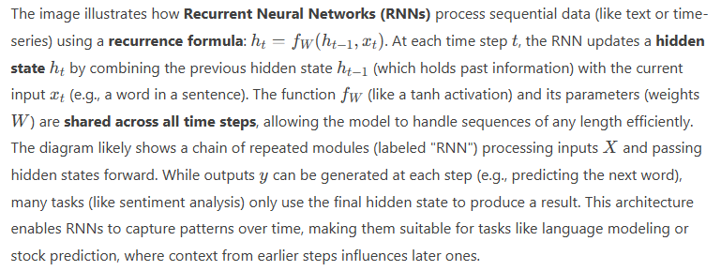
RNNs

Slide 14

(Vanilla) RNN
The state consists of a single “hidden” vector h
y
RNN
h
x

Slide 15
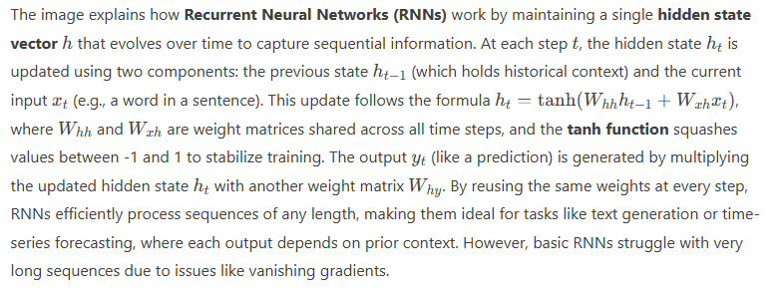
(Vanilla) RNN

Slide 16
Backpropagation is used!
Treat the unfolded network as one big feed-forward network!
Compute gradients through the usual backpropagation
Update shared weights

Slide 17
Example: Sentiment Classification
Classify a review review from Yelp or movie review from IMDB
…..As positive or negative
Inputs – one or more sentences consisting of multiple words
Output – Positive / Negative classification
Eg : ”The food as really good” “It was a fantastic movie”

Slide 18
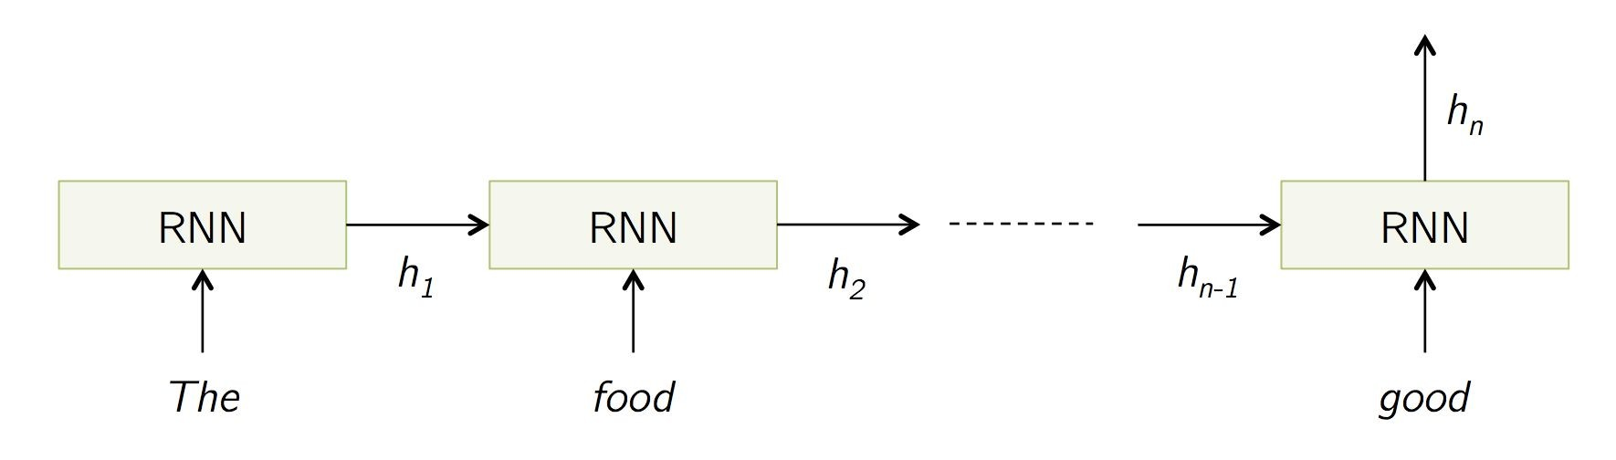
Sentiment Classification
You first change your words into vector embedding and then feed into the RNN
The RNN that receives a sequence of vectors as input and considers the order of the vectors to generate prediction.

Slide 19
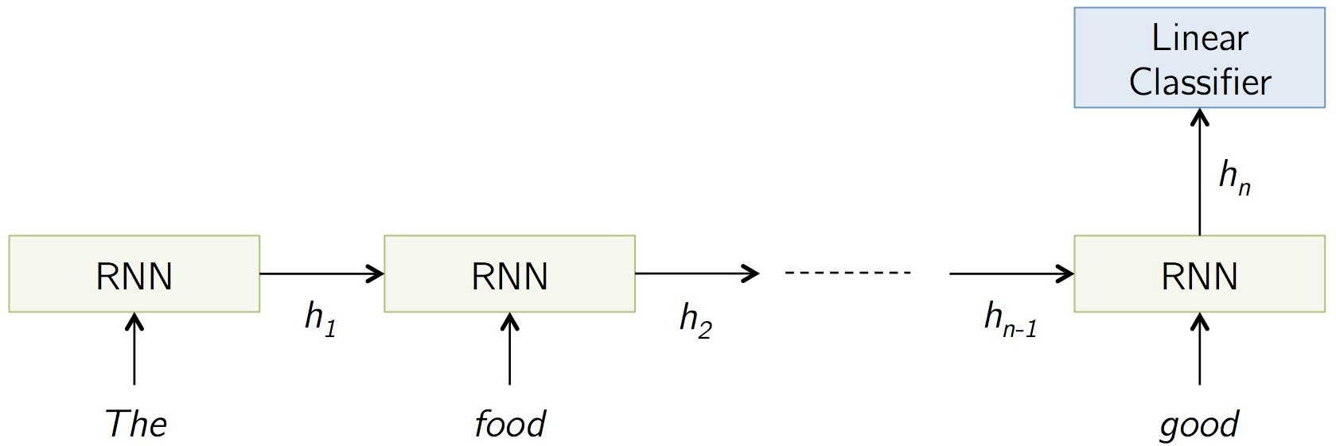
Sentiment Classification
We are using sigmoid because we are trying to predict if this text has positive or negative sentiment.
We don’t care about the sigmoid outputs except for the very last one, we can ignore the rest. We’ll calculate the cost from the output of the last step and the training label.
Positive/Negative

Slide 20
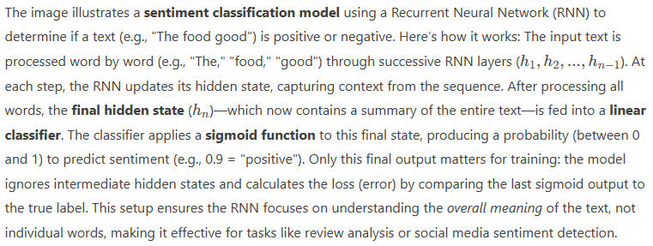
Sentiment Classification

Slide 21
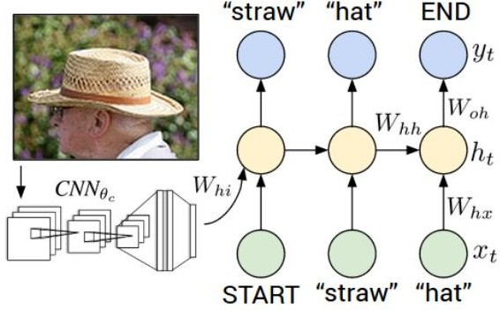
Image Captioning
Given an Image, generate a sentence describing its contents

Slide 22
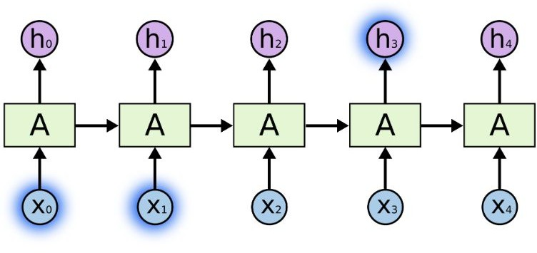
Problem of Long Term Dependencies
If we are trying to predict the last word in “the clouds are in the sky,” we don’t need any further context – it’s pretty obvious the next word is going to be sky.

Slide 23
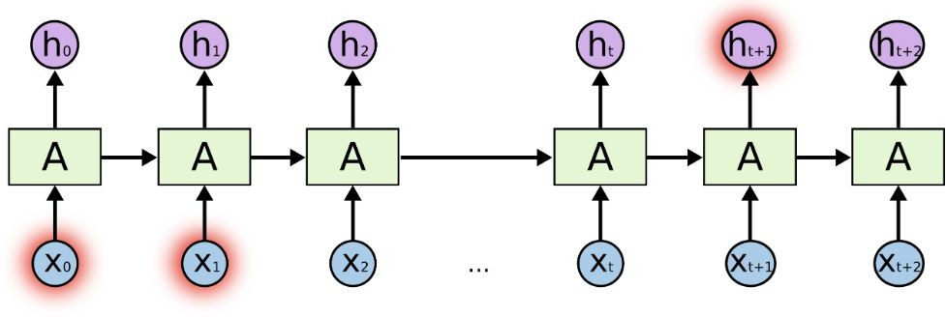
Problem of Long Term Dependencies
But there are also cases where we need more context. Consider trying to predict the last word in the text “I grew up in France… I speak fluent French.”

Slide 24
Problem of Long Term Dependencies
In theory, RNNs are absolutely capable of handling such “long-term dependencies.”
Sadly, in practice, RNNs don’t seem to be able to learn them.

Slide 25
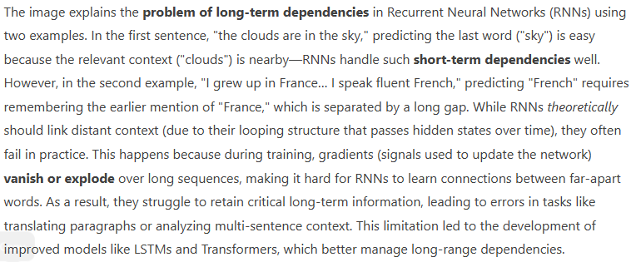
Problem of Long Term Dependencies

Slide 26
Vanishing / Exploding Gradients
In the same way a product of k real numbers can shrink to zero or explode to infinity, so can a product of matrices
For large values of W, the gradients will grow exponentially with time (exploding).
For very small values of W, the gradients will shrink exponentially with time (vanishing).

Slide 27
LSTMs do not have this problem!

Slide 28
LSTM (Long Short Term Memory)
Long Short Term Memory networks – usually just called “LSTMs” – are a special kind of RNN, capable of learning long-term dependencies.

Slide 29
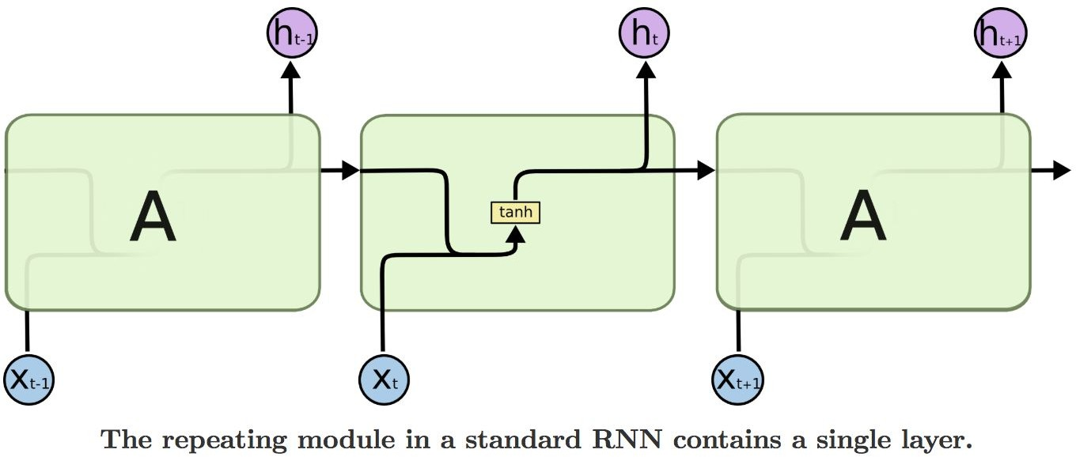
In standard RNNs, the repeating module will have a very simple structure, such as a single tanh layer.

Slide 30
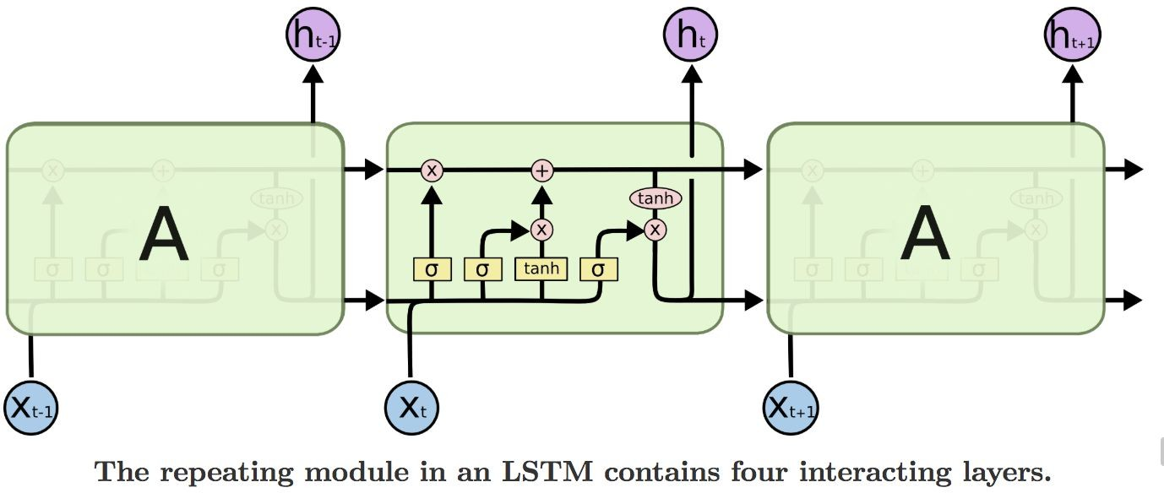


LSTMs also have this chain like structure, but the repeating module has a different structure. Instead of having a single neural network layer, there are four, interacting in a very special way.
$$C_{t−1}$$
$$C_{t}$$

Slide 31
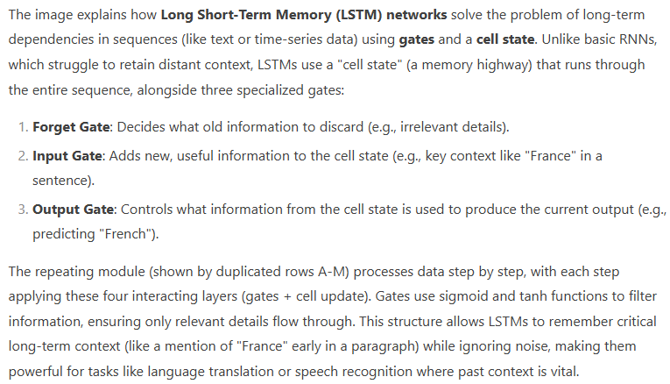


The LSTM does have the ability to remove or add information to the cell state, carefully regulated by structures called gates.
$$C_{t−1}$$
$$C_{t}$$
Gates are a way to optionally let information through.

Slide 32
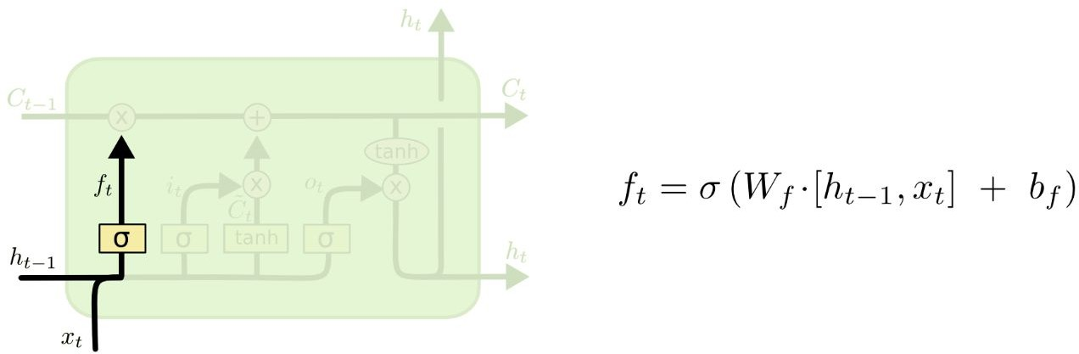
Forget Gate
Gates are a way to optionally let information through.

Slide 33
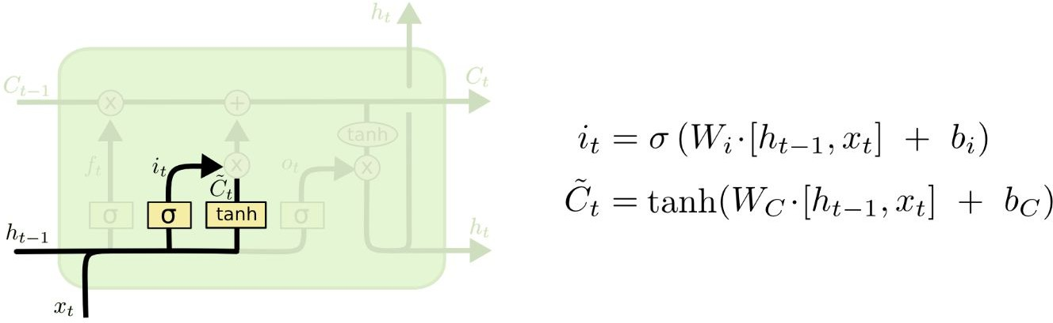
Input Gate
Gates are a way to optionally let information through.

Slide 34
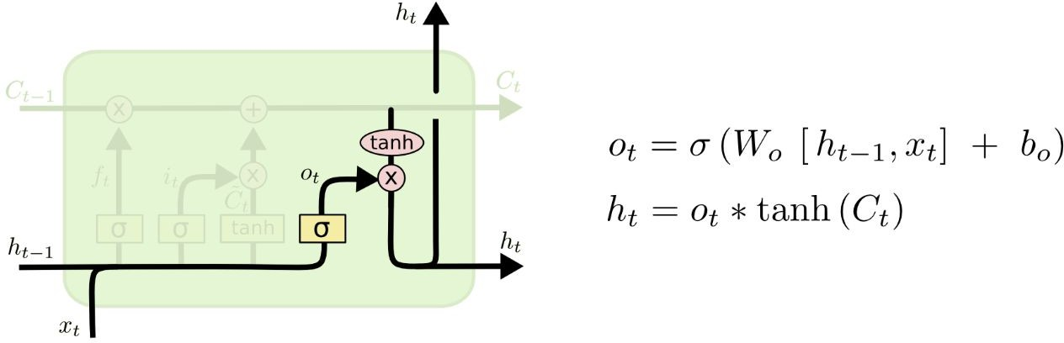
Output Gate
Gates are a way to optionally let information through.

Slide 35
Summary
RNNs are a widely used model for sequential data, including text
RNNs are trainable with backpropogation
RNNs learn complex and varied patterns in sequential data
Vanilla RNNs are simple but don’t work very well
- Backward flow of gradients in RNN can explode or vanish
Common to use LSTM or GRU. Memory path makes them stably learn long-distance interactions.

Slide 36
Thank You!

